Slide 1
DATA ANALYTICS PROCESS: Real world application
Project done by:
DIVYANI SIROHI

Slide 2

DATA ANALYTICS PROCESS: Real world application
Topic: Fitness Tracking and Exercise Routine Optimization

Slide 3
DATA ANALYSIS
Data analysis is a process of inspecting, cleansing, transforming, and modelling data with the goal of discovering useful information, informing conclusions, and supporting decision-making.
Data analysis used in different business, ecommerce, technologies, healthcare industries, science, and social science domains, .
In today's business world, data analysis plays a role in making decisions more scientific and helping businesses operate more effectively.
we are using Data Analytics in daily life to enhance productivity and remain profitable.

Slide 4
Case Study: Data Analysis in Real life
Scenario
Plan
An individual decides to improve their fitness and sets a goal to exercise regularly. They plan their exercise routine, considering factors such as their current fitness level, time availability, and desired fitness outcomes
Prepare
The individual prepares for their exercise routine by selecting suitable workout activities and scheduling them into their weekly calendar.
Process
the individual uses fitness tracking devices such as smartwatches or fitness apps to monitor their activity levels, heart rate, and calorie expenditure.
Analyze
After each workout session, the individual analyses the data collected by their fitness tracking devices to assess their performance and progress towards their fitness goals.
Share
The individual may share their workout data and progress with friends, family, or online communities through social media or fitness tracking platforms also join online fitness challenges or groups to connect with others who share similar goals and provide support.
Action
the individual adjusts their exercise routine as needed to optimize their performance and achieve their fitness goals more effectively. They may modify the intensity, duration, or frequency of their workouts and experiment with different exercises or training techniques.

Slide 5
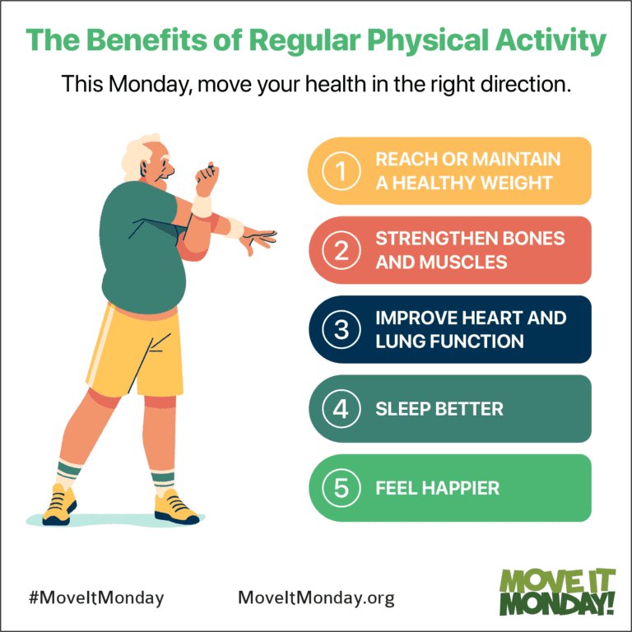

Data Analytics steps:
Plan: An individual decides to improve their fitness and sets a goal to exercise regularly. They plan their exercise routine, considering factors such as their current fitness level, time availability, and desired fitness outcomes (e.g., weight loss, muscle gain, improved cardiovascular health).

Slide 6
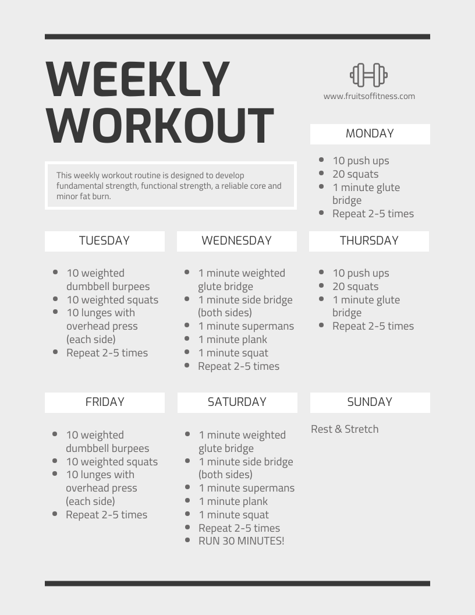
Prepare:
The individual prepares for their exercise routine by selecting suitable workout activities and scheduling them into their weekly calendar. They may also gather relevant equipment orclothing needed for their workouts and ensure they have access to facilities like a gym or outdoor space.

Slide 7
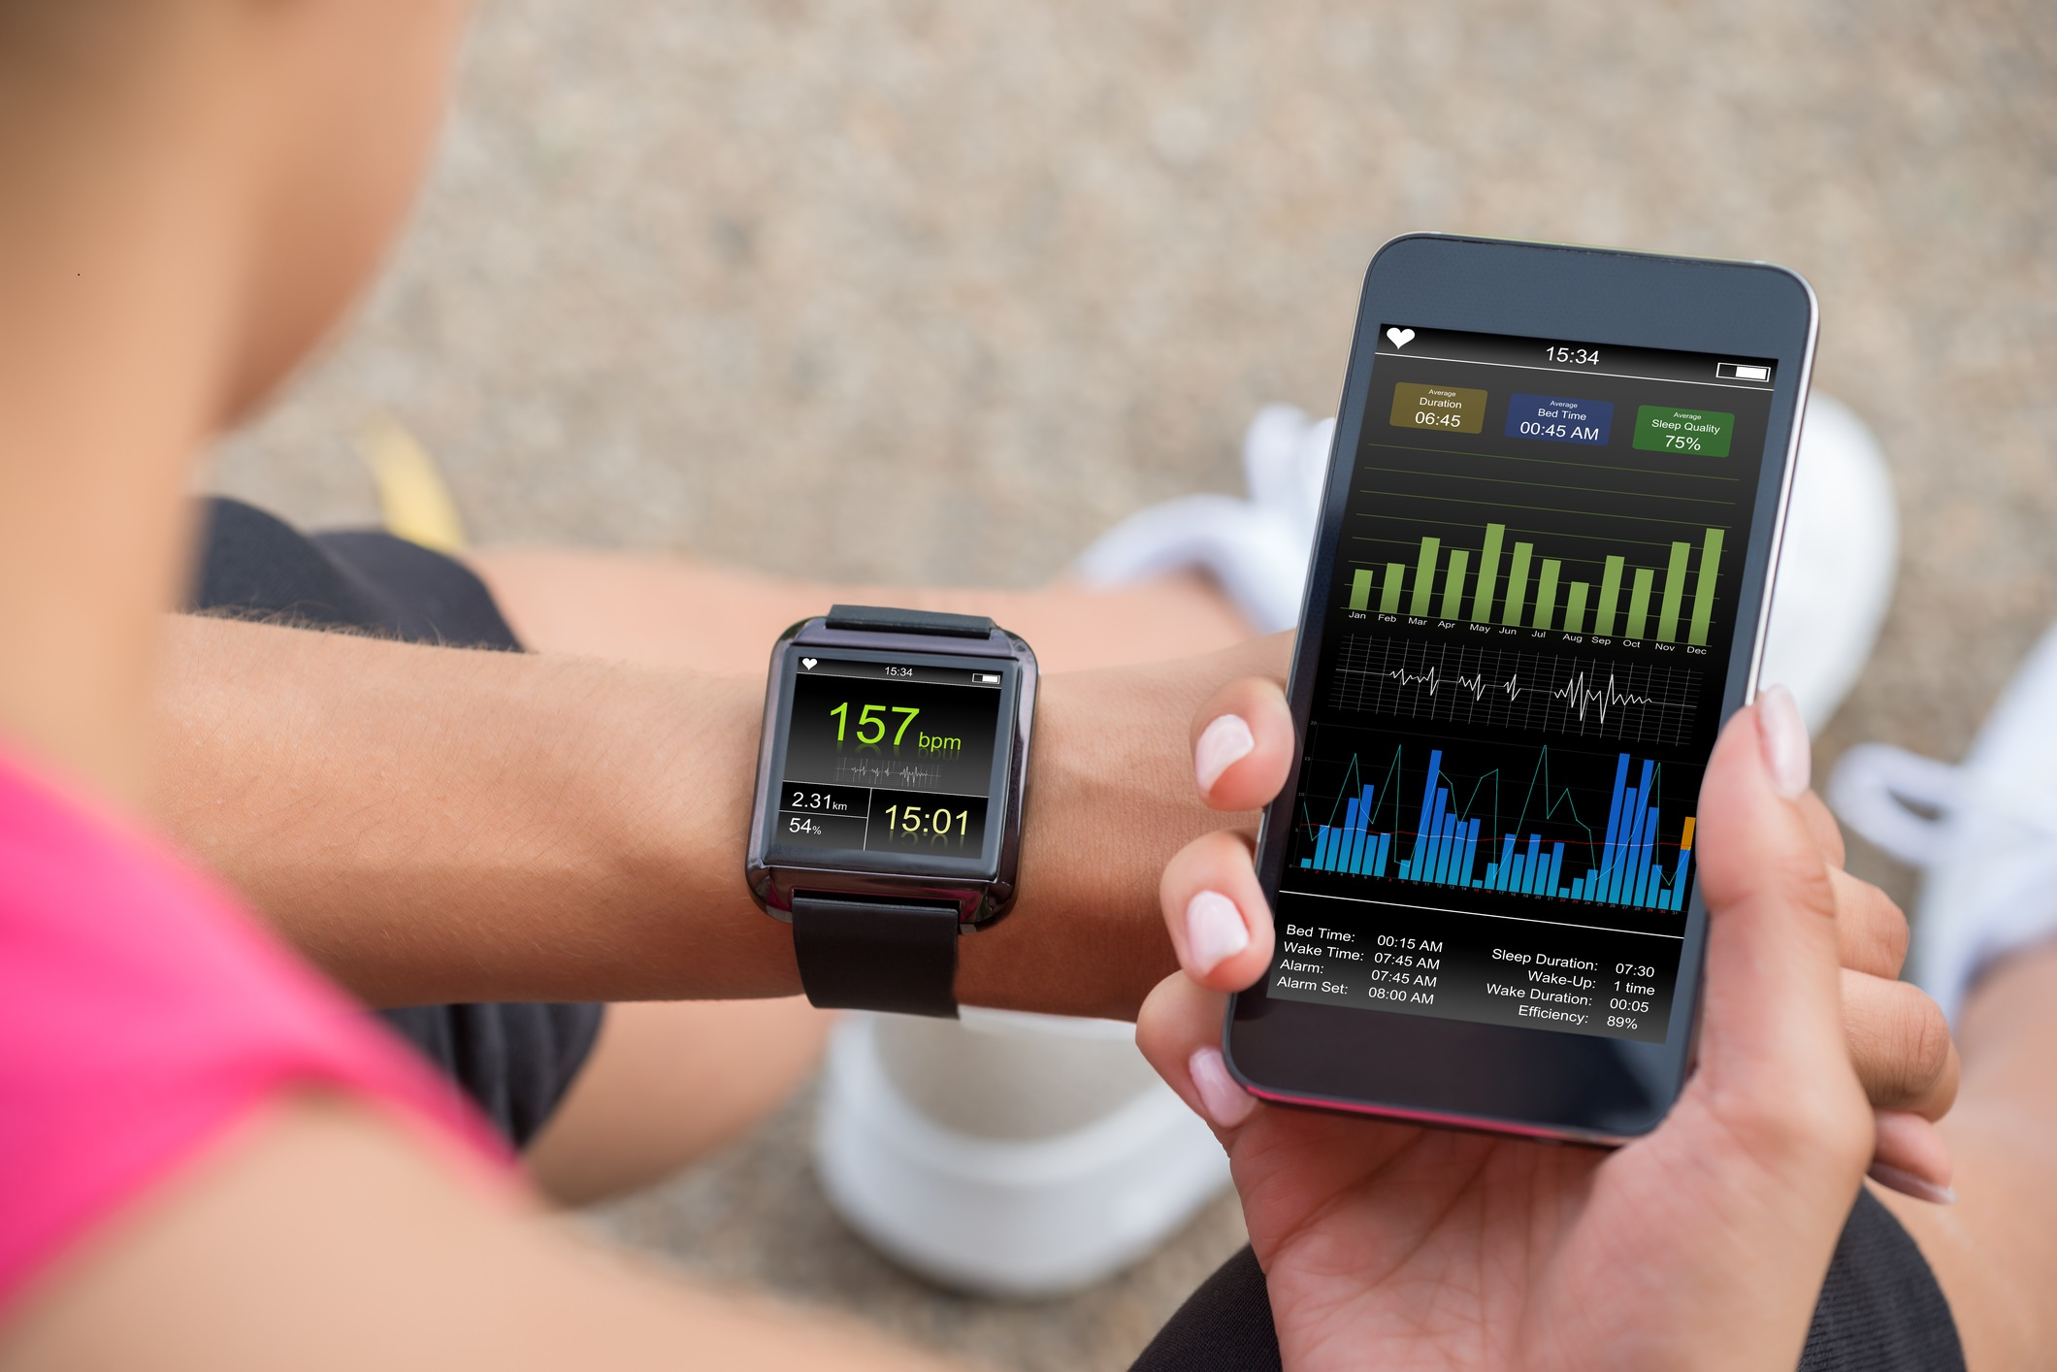
Process:
During their workouts, the individual uses fitness tracking devices such as smartwatches or fitness apps to monitor their activity levels, heart rate, and calorie expenditure. These devices collect data in real-time, tracking metrics like steps taken, distance covered, and duration of exercise.

Slide 8

Share:
The individual may share their workout data and progress with friends, family, or online communities through social media or fitness tracking platforms. They may also join online fitness challenges or groups to connect with others who share similar goals and provide support and encouragement.

Slide 9
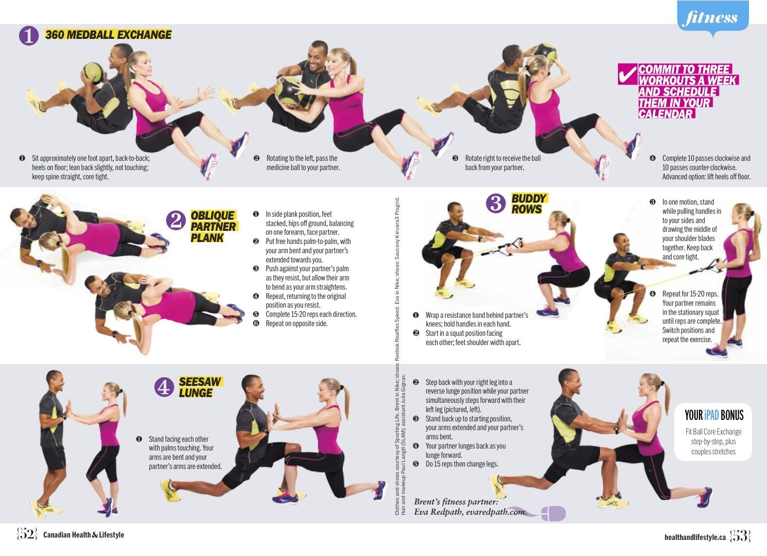
Action:
Based on the insights gained from analysing their workout data, the individual adjusts their exercise routine as needed to optimize their performance and achieve their fitness goals more effectively. They may modify the intensity, duration, or frequency of their workouts and experiment with different exercises or training techniques.

Slide 10
Example Elaboration:
Suppose Ajay decides to improve his overall fitness by incorporating regular exercise into his routine. He plans to exercise four times a week, focusing on a combination of cardio and strength training to enhance his cardiovascular health and build muscle tone.
Ajay prepares for his workouts by selecting a variety of activities, including running, cycling, weightlifting, and bodyweight exercises. He schedules his workouts in the mornings before work and ensures he has the necessary equipment and attire, such as running shoes, dumbbells, and workout clothes.
During his workouts, Ajay wears a smartwatch with built-in fitness tracking capabilities. The smartwatch monitors his heart rate, tracks his running routes via GPS, and records his workout duration and intensity. Meanwhile, a fitness app on his smartphone logs additional details such as his calorie expenditure and exercise milestones.

Slide 11
Continue…..
After each workout, Ajay analyses the data collected by his smartwatch and fitness app to evaluate his performance. He reviews metrics like his average heart rate, pace per mile, and calories burned to assess the effectiveness of his workouts and identify areas for improvement.
Ajay shares his workout data and progress with his friends and family through social media. He posts updates about his exercise achievements, shares photos from his runs and workouts, and participates in virtual fitness challenges with his online community.
Based on the insights gained from analysing his workout data, Ajay adjusts his exercise routine to optimize his fitness progress. He increases the intensity of his cardio workouts by incorporating interval training and adds more resistance exercises to his strength training sessions to target specific muscle groups.
In this example, data analytics plays a crucial role in Ajay’s fitness journey, from planning and preparing his exercise routine to analysing his workout data and optimizing his performance. By leveraging technology and data-driven insights, Ajay can track his progress more effectively and make informed decisions to achieve his fitness goals.

Slide 12
Conclusion :
Data Analytics is holds a much important role in nowadays. In this new a era, billions of data is generating per second, Data helps you understand performance providing the clarity needed for better results. Data helps you improve processes so that you can reduce wasted money and time.
Key takeaways :
Plan it well in detailed manner of timing and resources, used to achieve an objective the best
prepare a brief summary about your work before proceeding
Analysis helps you in order to explore and interpret the matter, methodically and in detail to get the insights
Sharing the views helps you to do correctness and get into right way

Slide 13
THANK YOU!
Project Done by:
Divyani sirohi

